Slide 1



‘22
Organized by
Rajasthan Institute Of Engineering And Technology Jaipur
(Affiliated to Rajasthan Technical University, Kota and Approved by AICTE, New Delhi)
30th March 2022
Project
b. Team Name- team07
c. Team Leader- Vikas bairwa and Members Name-
(Santosh Kumar ,bicky verma )
d. Technology Name- digital .

Slide 2

Problem Statement
Describe about the problem you are focusing.
Lot of paper –work.
Teacher student ratio is less.
Curriculum should be updated.
Lack of vocational courses.
Very expensive education.

Slide 3

Existing Solutions
Describe about the solutions already there in market solving the same targeted Problem.
Smart classes.
Education apps.
Eco friendly transportation.

Slide 4
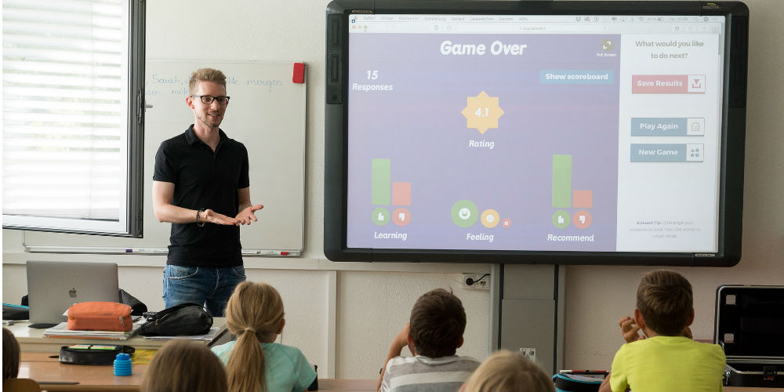
Proposed Solutions
Describe your idea, how you are trying to solve the problem and how it is different from the existing ideas.
Digital textbook .

Slide 5
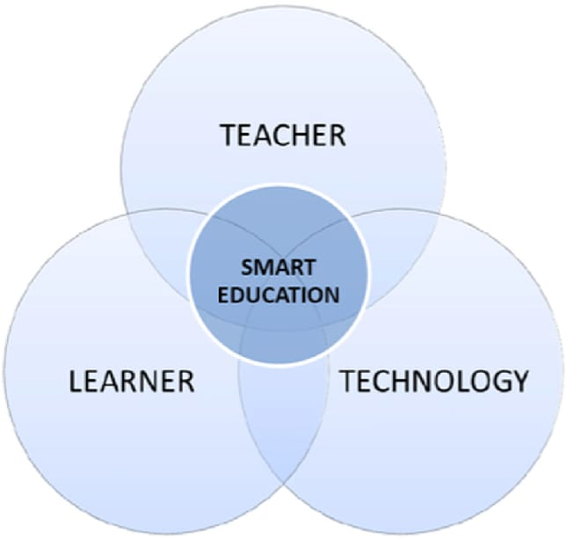
Functionality
Explain the system working and its functionality and features (if any).
Formal and informal learning.
Smatboards – this is an interactive whiteboard which allows the teacher can degitally draw on that emage.
Digital podium
smart phone
Laptop band pc
Visualizers.

Slide 6
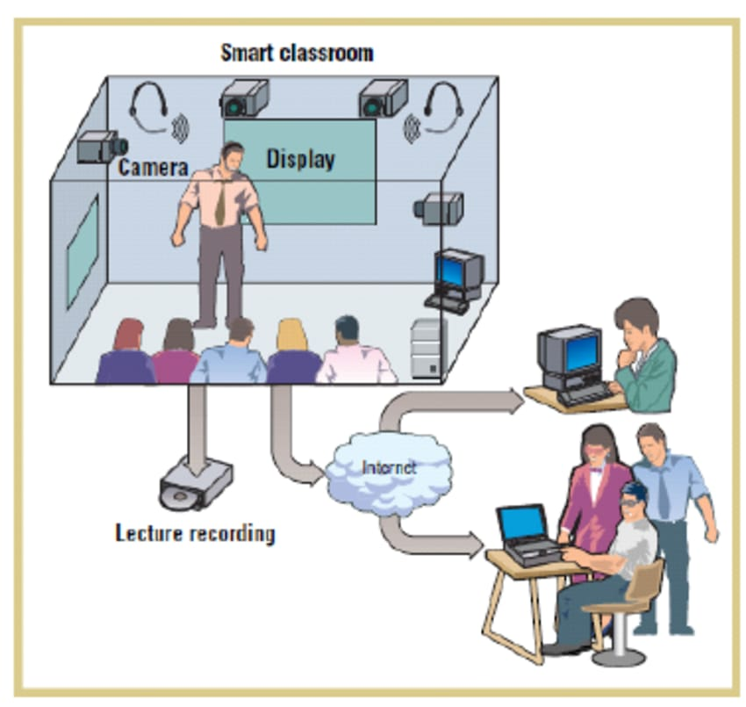
Merits
Describe advantages of your system/idea/prototype.
Euhanced learning experience.
Time saving technology.
Increased productivity.

Slide 7
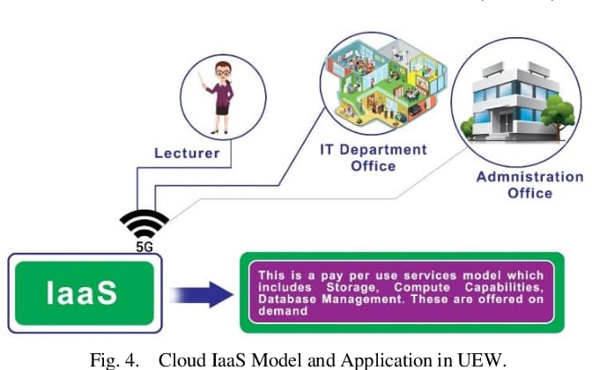
Applications
List the application area of your idea/system/prototype where your idea/system/prototype can be used.
Arts.
Foren language.
Science.
Technology.

Slide 8
THANK YOU
Note – Smart education the file as Team07 From cse branch 1st year.

